Slide 1

Data Processing Project: Investigating BioPython
Anna van Tiel

Slide 2
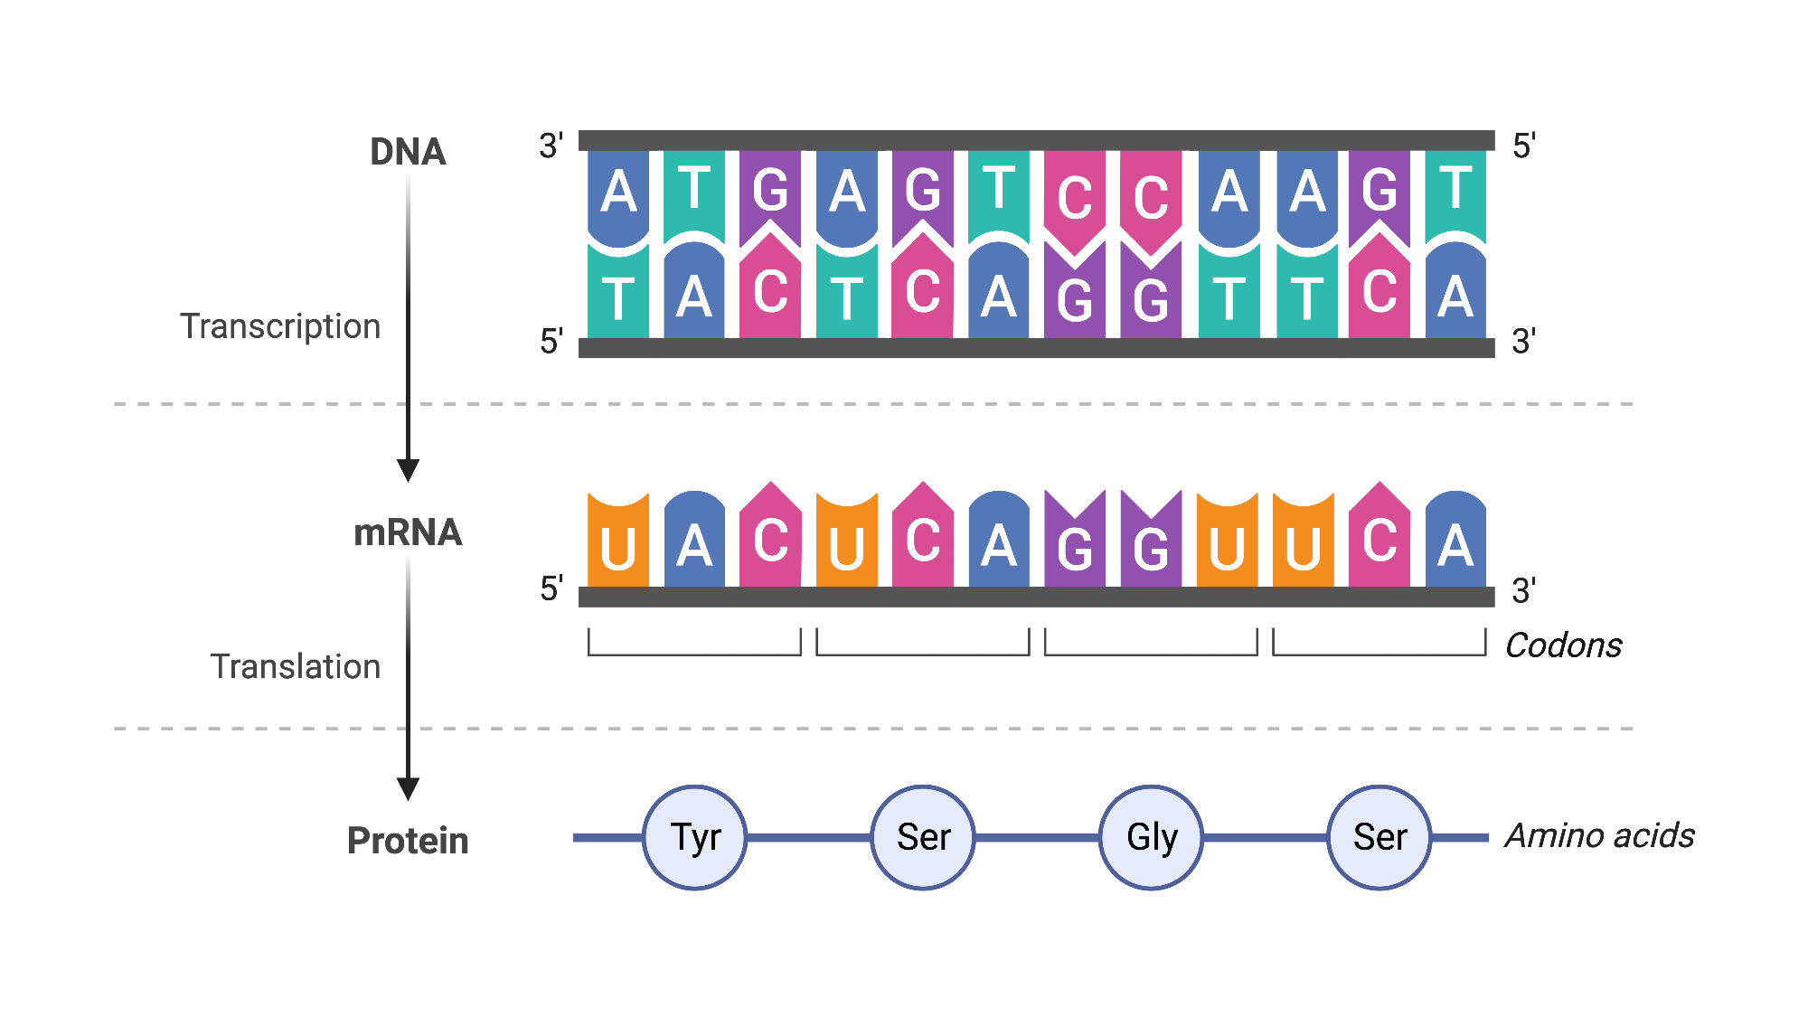
Central dogma: DNA encodes proteins

Slide 3
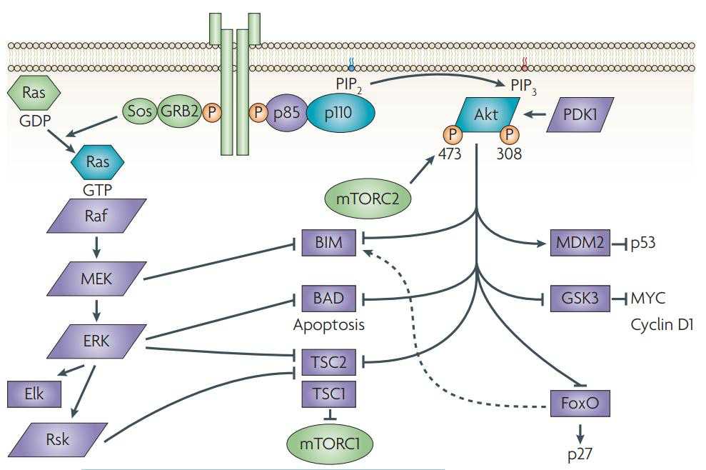
The Akt1 protein

Slide 4
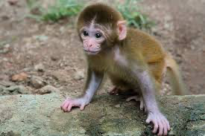
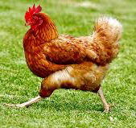
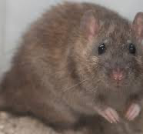
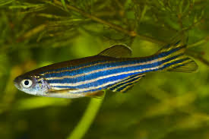


Akt1 is found in many species

Slide 5
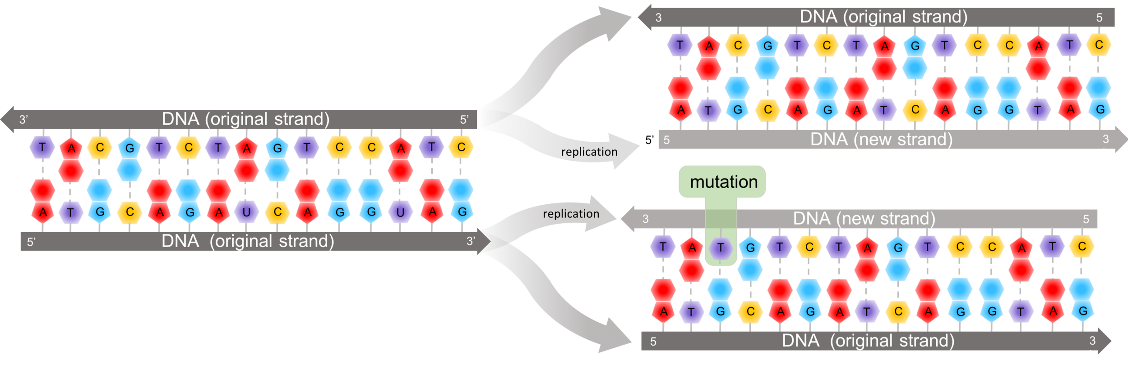
Is there evidence for evolutionary pressure on the Akt1 protein?

Slide 6
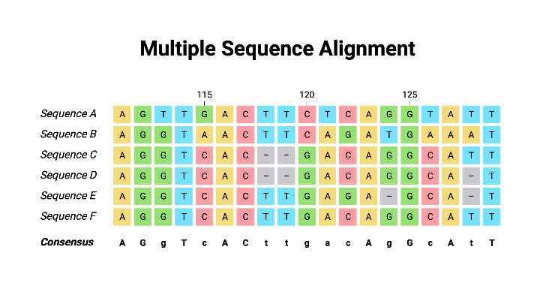
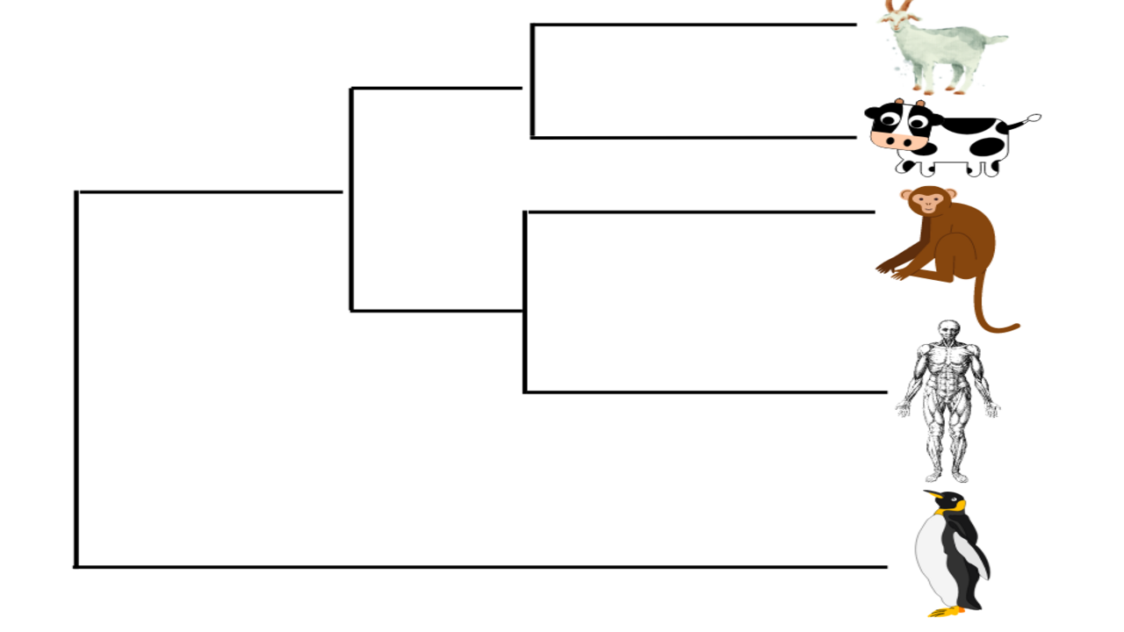
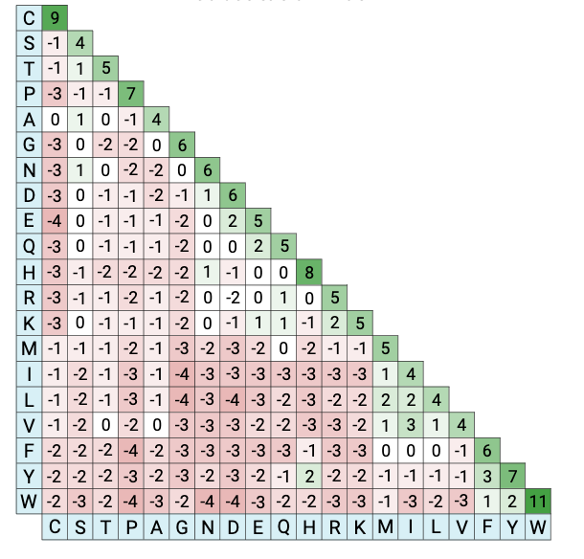
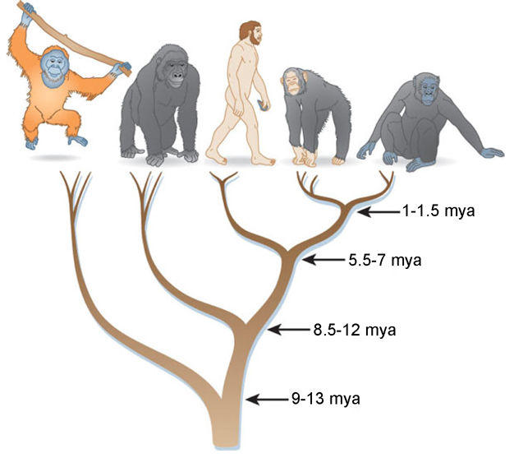
Method overview
1
2
4
3

Slide 7
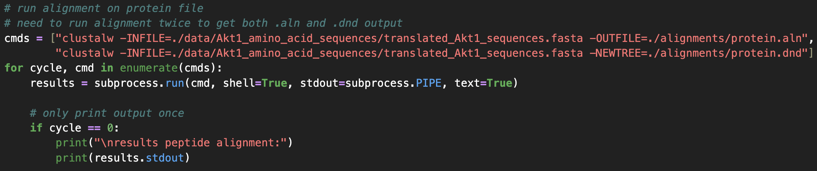
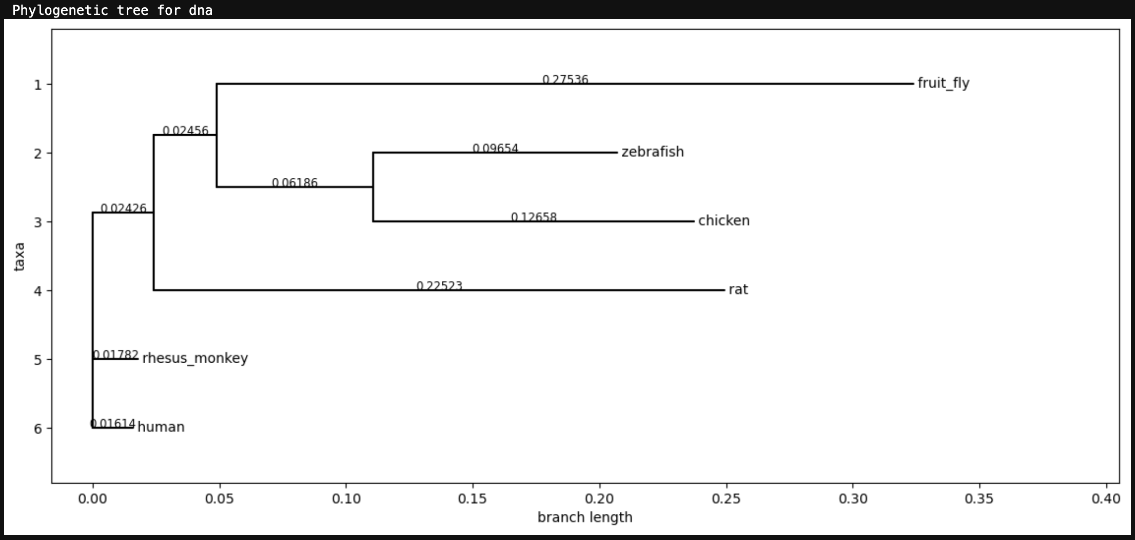
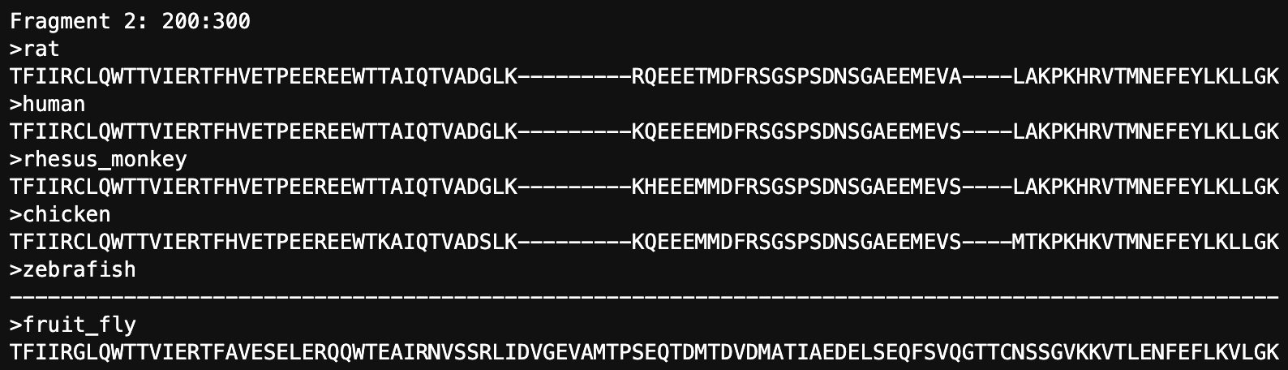
Multiple sequence alignment (MSA)
Rhesus monkey and human Akt1 genes are 96% identical!
Result: fruit fly most divergent, zebrafish protein seems truncated

Slide 8
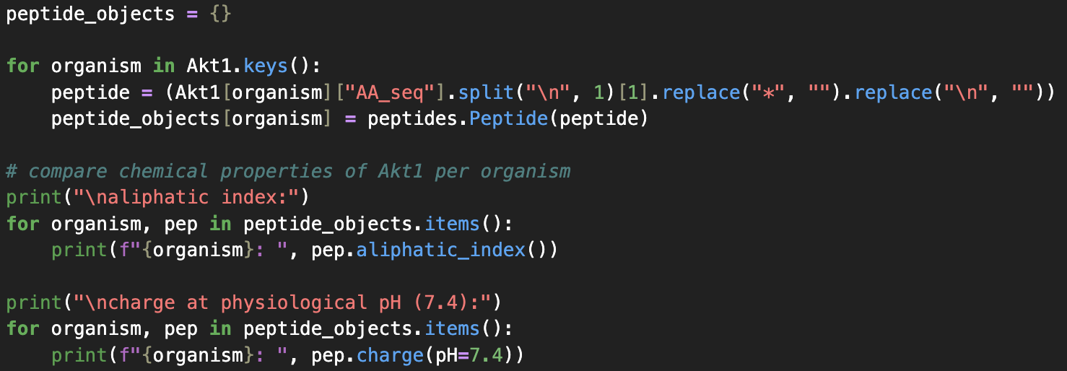
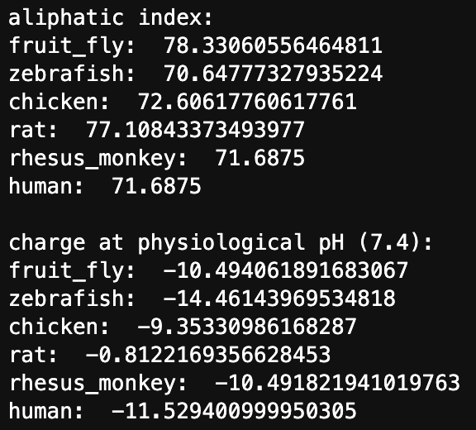
Whole protein investigation: physiochemical properties

Slide 9
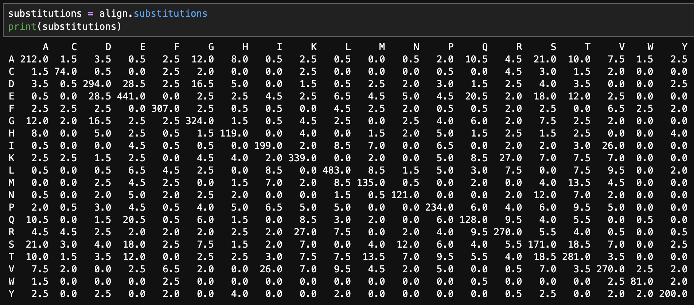
Single amino acid conservation

Slide 10
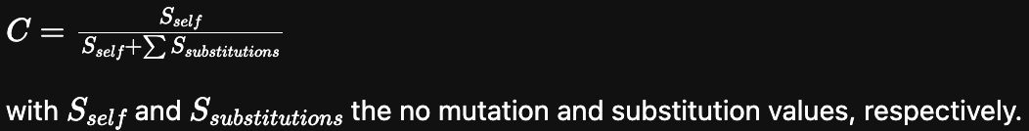
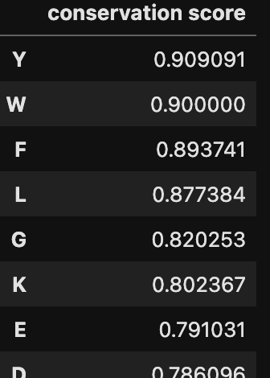
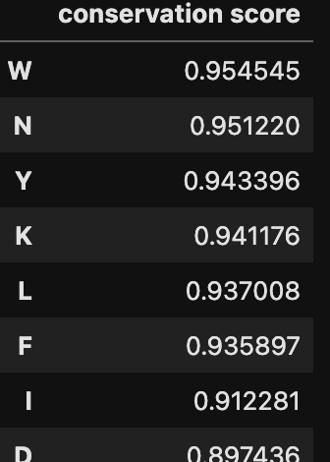
Single amino acid conservation
Computation of conservation score C :
All species:
Human, rhesus monkey, rat:

Slide 11
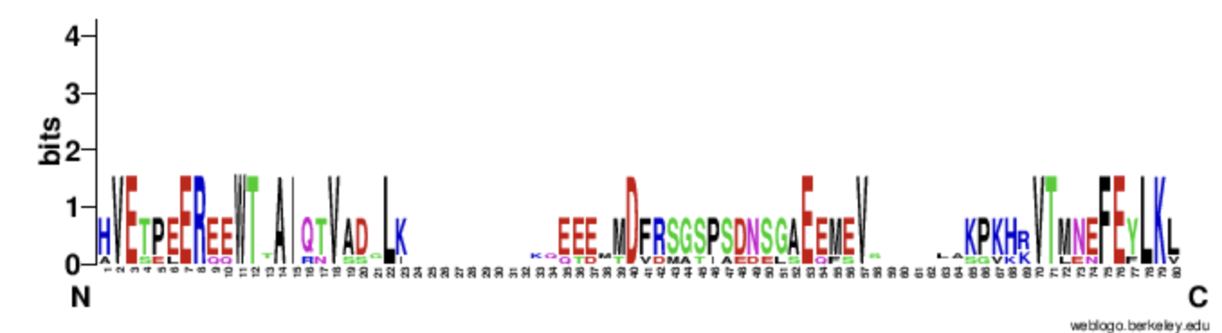
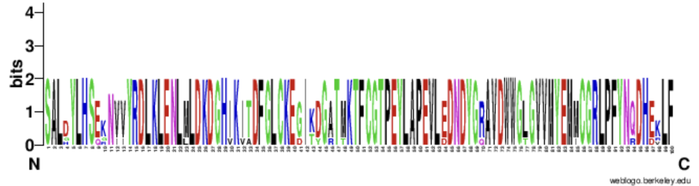
Conserved motifs
Poorly conserved
Highly conserved

Slide 12
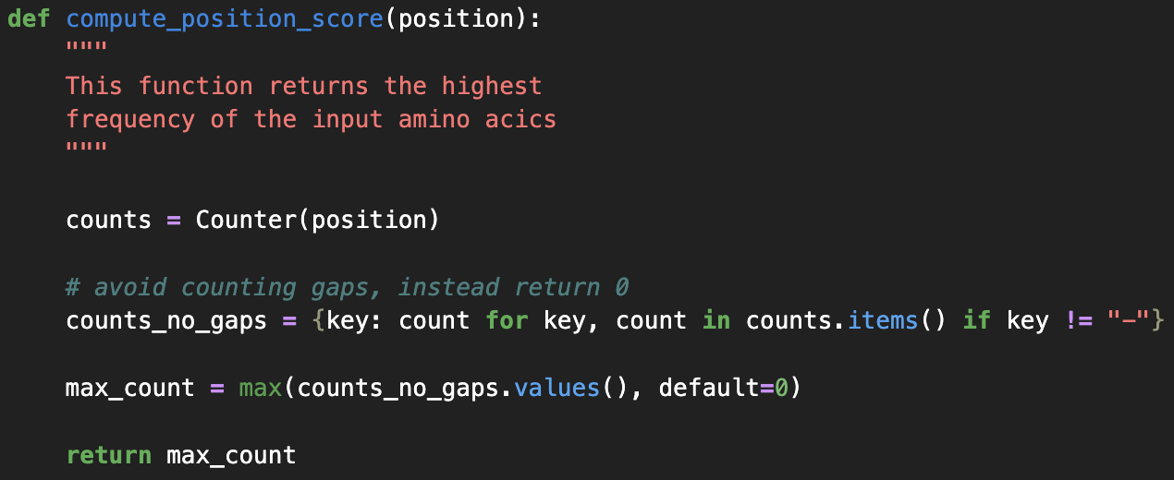
Conserved motifs

Slide 13
Conserved motifs

Slide 14
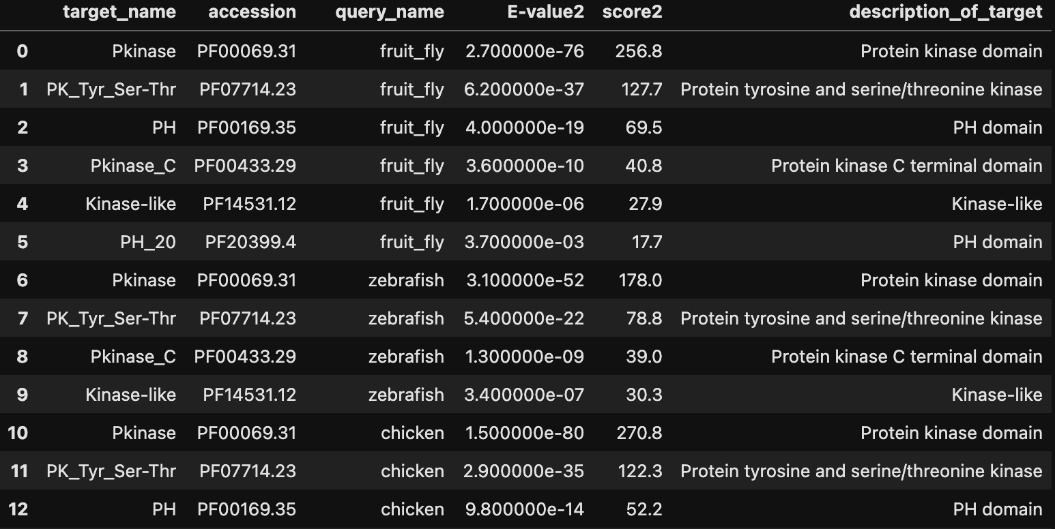
Matching domains from Pfam db

Slide 15
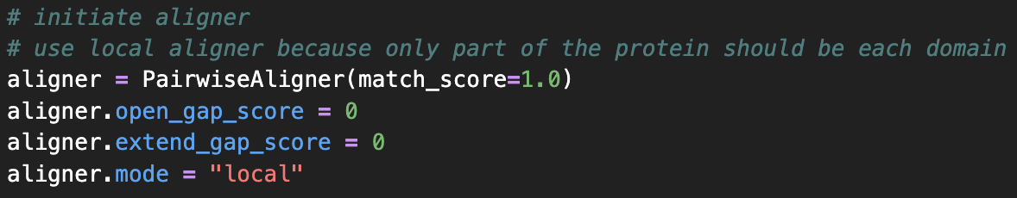
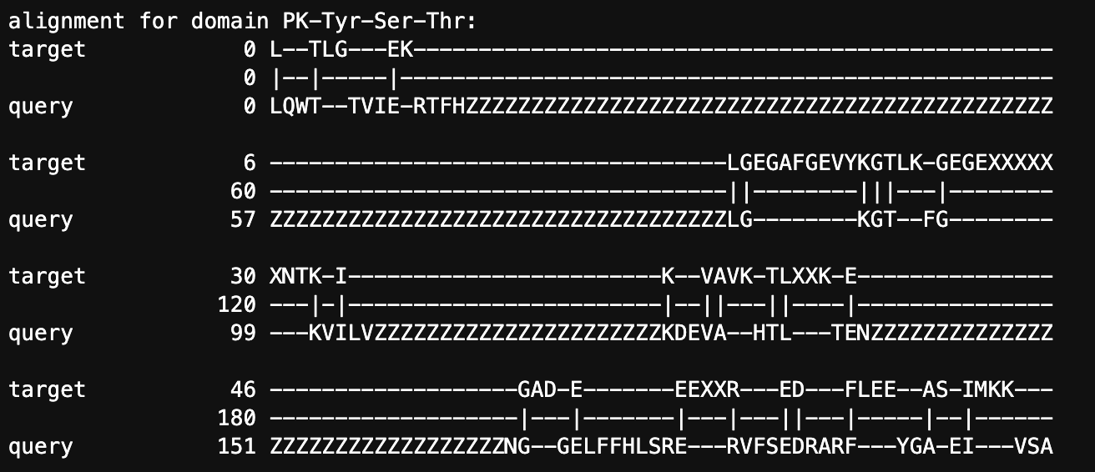
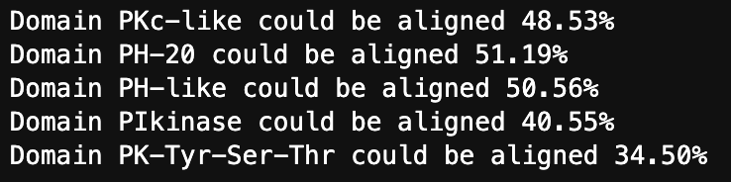
Poor alignment of conserved motifs
Don’t let you get fooled!

Slide 16
Conclusion
The following evidence for evolutionary pressure on Akt1 proteins is available:
Highly similar gene and protein sequences across diverse species
Similar physiochemical properties
Single amino acid conservation scores up to 95% in related species
Stretches of sequences conserved >80% at each position up to 54 amino acids
No evidence that conservation centres in functional domains.

